Slide 1
Tripping the light GANtastic:
Understanding objects and scenes with Generative Adversarial Networks
Matt Phillips
Presentation to IEEE ENCS RA24 chapter meeting Feb. 5, 2018

Slide 2
Liu et al. NIPS 2017

Slide 3
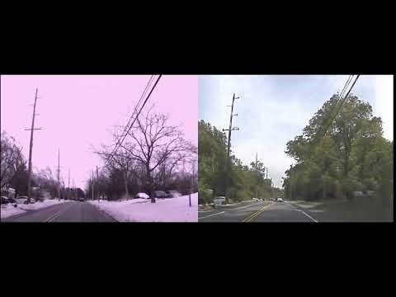
Image translation: Left is input, right is output
Liu et al. NIPS 2017

Slide 4
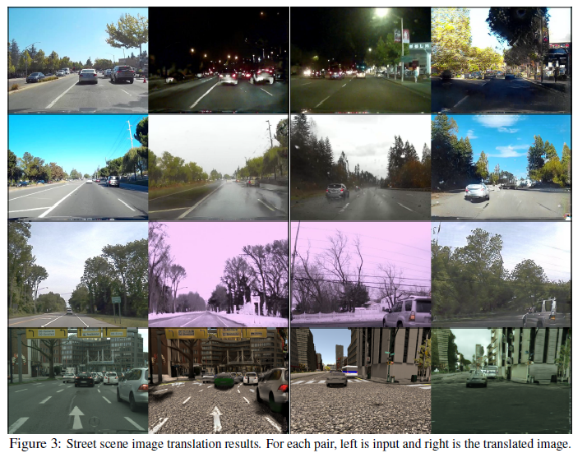
Image translation: Left is input, right is output
Liu et al. NIPS 2017

Slide 5
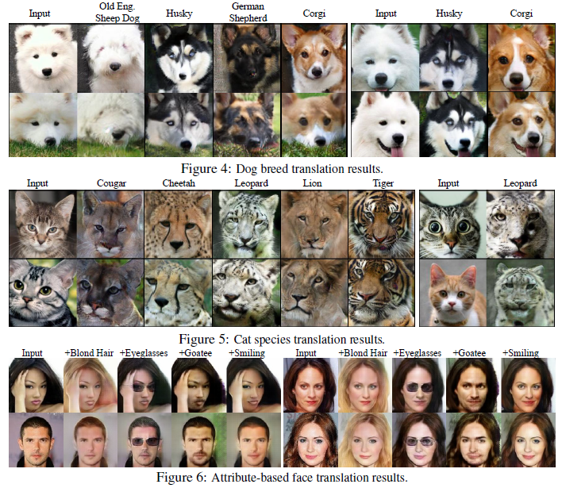
Image translation
Liu et al. NIPS 2017

Slide 6
So, what’s going on here?
Maybe we’ve just found the video in the ‘sunny day’ video database that most looks like the input ‘snowy day’ video.
Not the case!
  Actually the system has never seen the input video before
  And the output exists in no database.
  Rather

Slide 7
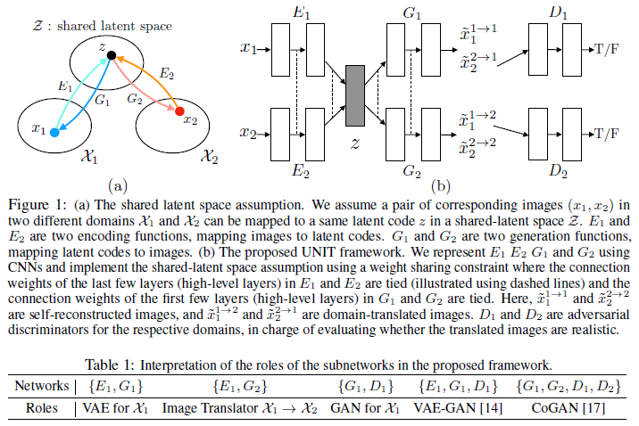

Slide 8
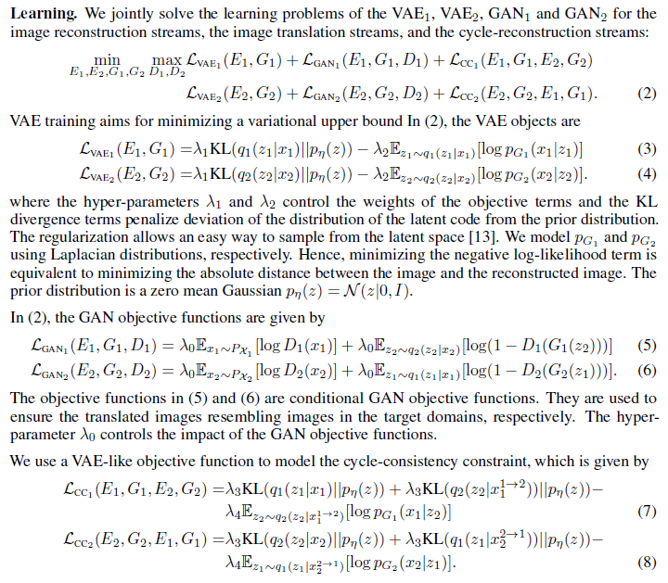

Slide 9
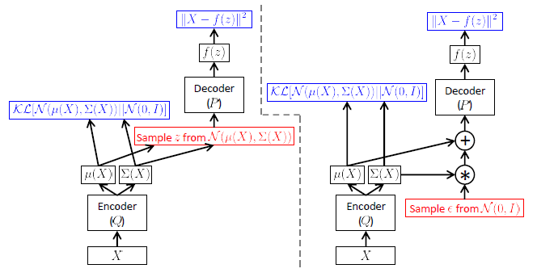

Slide 10
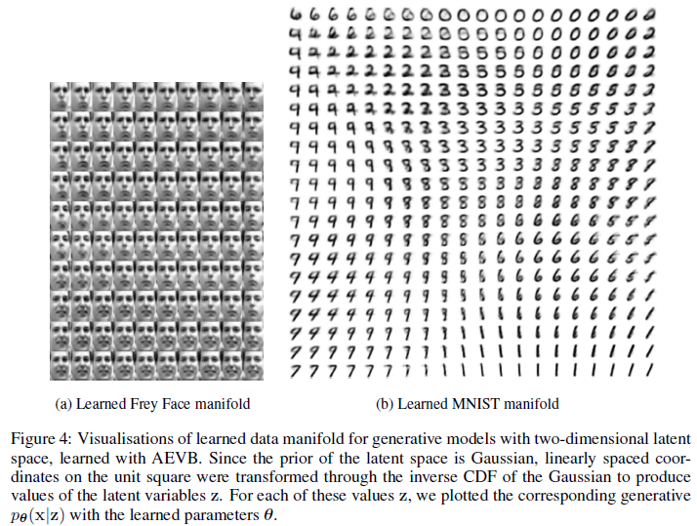

Slide 11
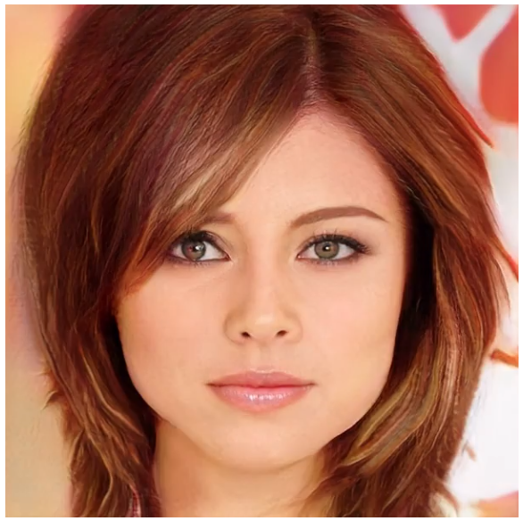

Slide 12
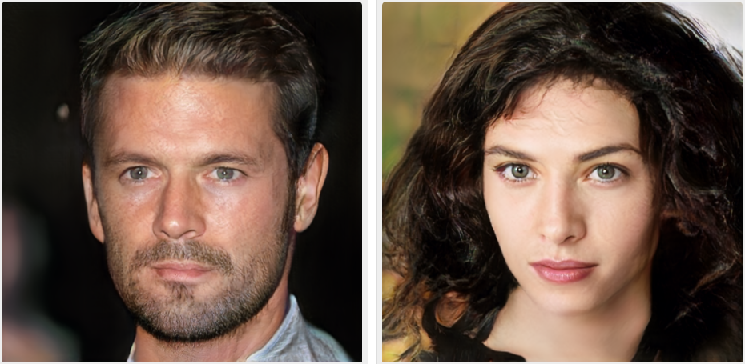

Slide 13
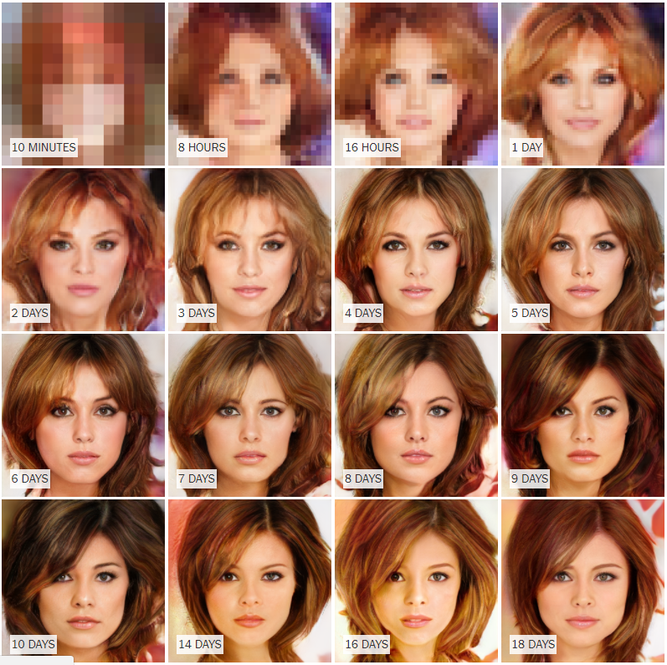

Slide 14
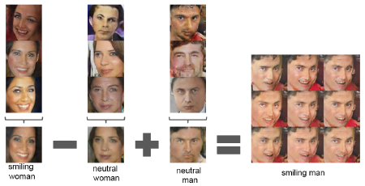

Slide 15
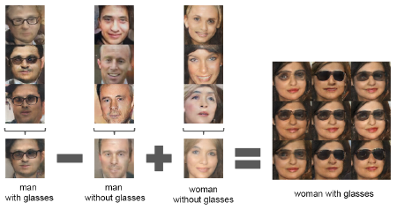

Slide 16
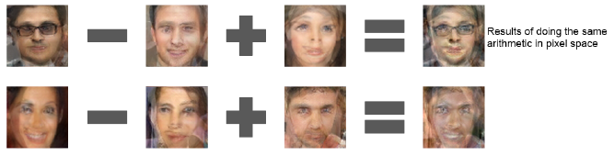
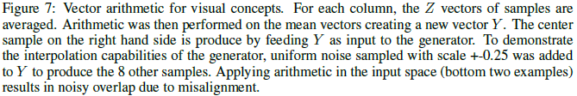

Slide 17
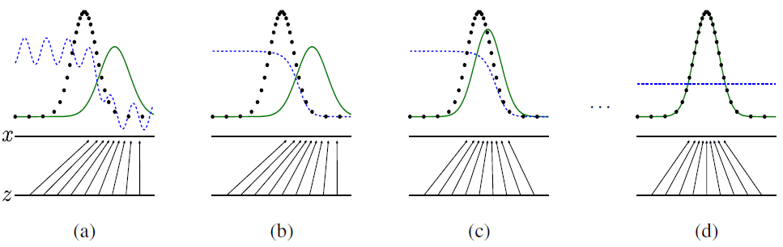

Slide 18
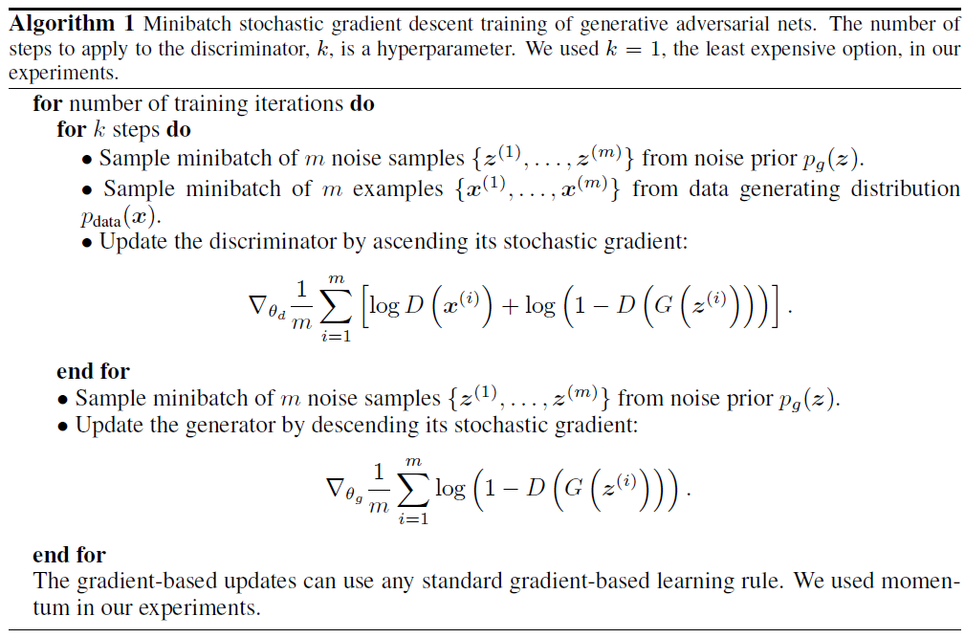

Slide 19
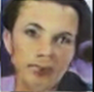
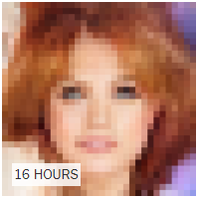
Generative Adversarial Network
Discriminator
{0, 1}
Generator

